Slide 1
Lecture 2
Introduction & Fundamentals of Image Processing
Ref. Digital Image Processing
By Rafael. C. Gonzalez

Slide 2

Introduction
What is Digital Image Processing?
Digital Image
— a two-dimensional function
x and y are spatial coordinates
The amplitude of f is called intensity or gray level at the point (x, y)
Digital Image Processing
— process digital images by means of a computer, it covers low-, mid-, and high-level processes
low-level: inputs and outputs are images
mid-level: outputs are attributes extracted from input images
high-level: an ensemble of recognition of individual objects
Pixel
— the elements of a digital image

Slide 3
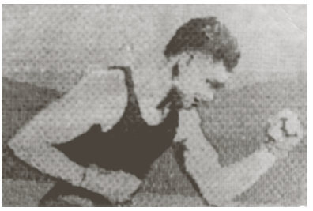
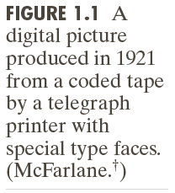
Origins of Digital Image Processing
Sent by submarine cable between London and New York, the transportation time was reduced to less than three hours from more than a week

Slide 4
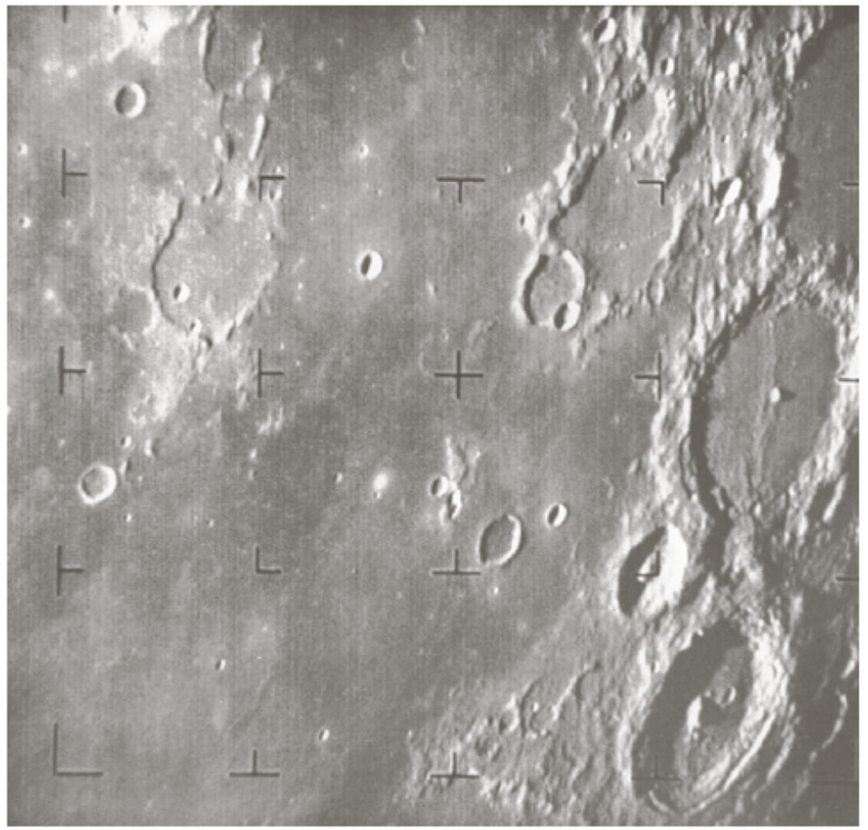
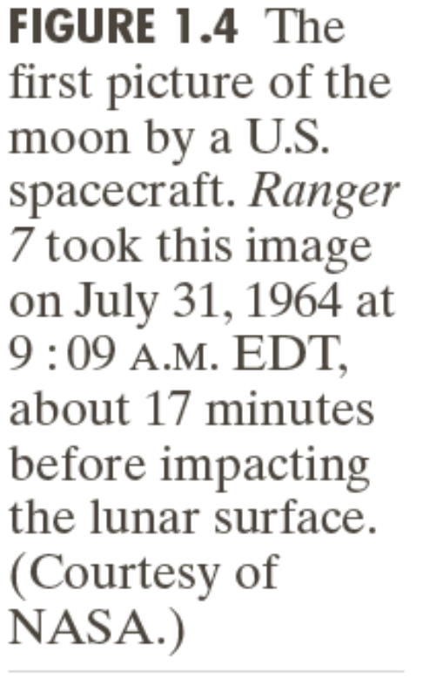
Origins of Digital Image Processing

Slide 5
Sources for Images
Electromagnetic (EM) energy spectrum
Acoustic
Ultrasonic
Electronic
Synthetic images produced by computer
Weeks 1 & 2

Slide 6
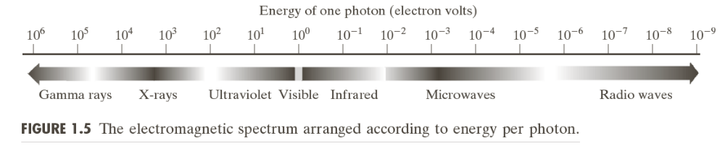
Electromagnetic (EM) energy spectrum
Major uses
Gamma-ray imaging: nuclear medicine and astronomical observations
X-rays: medical diagnostics, industry, and astronomy, etc.
Ultraviolet: lithography, industrial inspection, microscopy, lasers, biological imaging,
and astronomical observations
Visible and infrared bands: light microscopy, astronomy, remote sensing, industry,
and law enforcement
Microwave band: radar
Radio band: medicine (such as MRI) and astronomy
Weeks 1 & 2

Slide 7
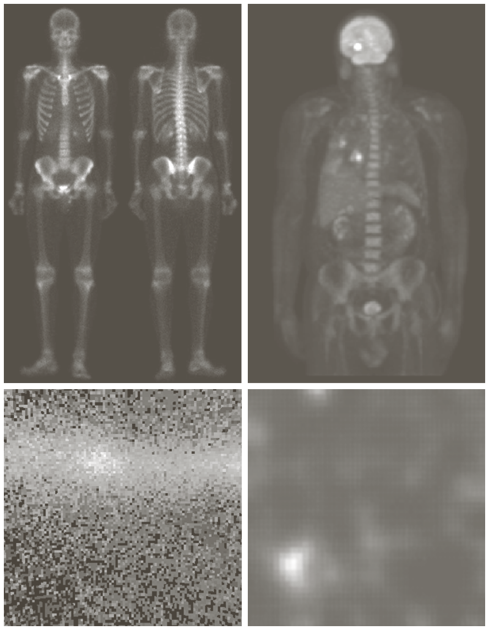
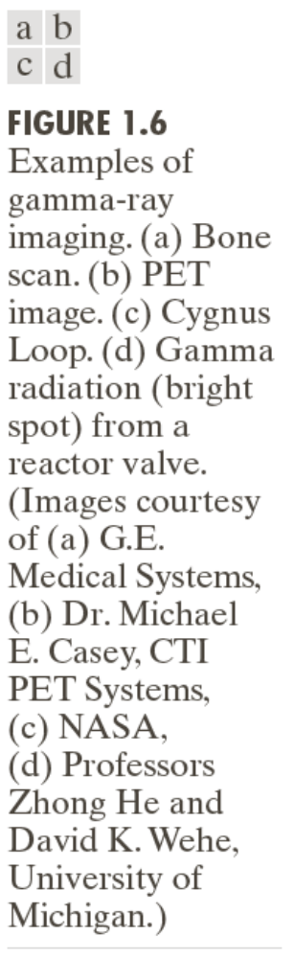

Examples: Gama-Ray Imaging
Weeks 1 & 2

Slide 8
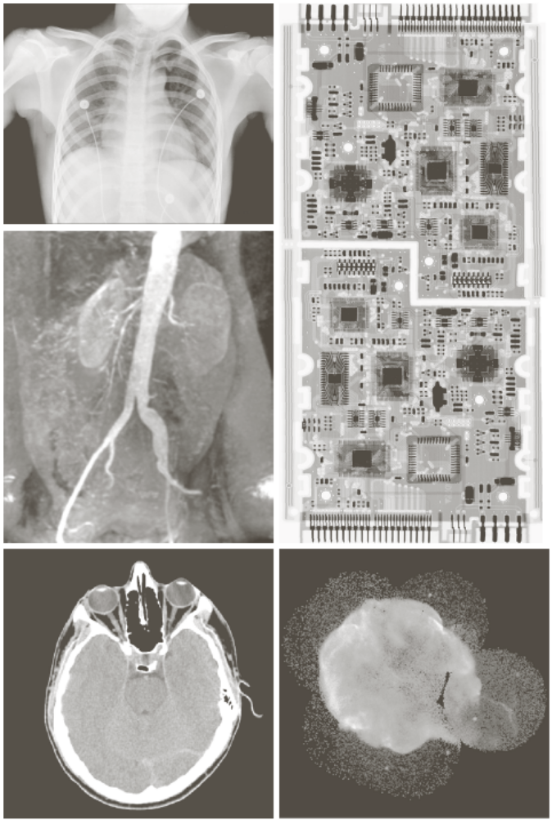
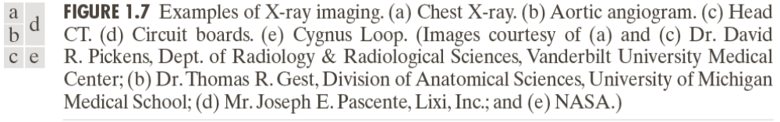
Examples: X-Ray Imaging
Weeks 1 & 2

Slide 9
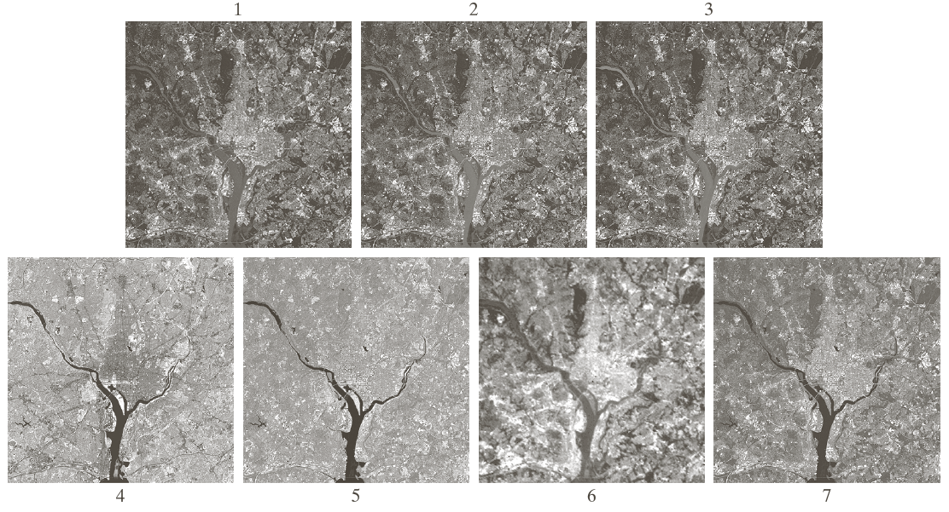
Examples: Visual and Infrared Imaging
Weeks 1 & 2

Slide 10
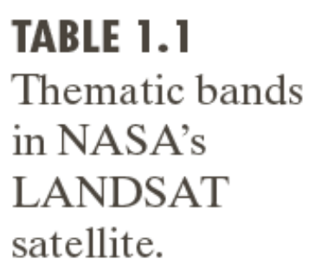
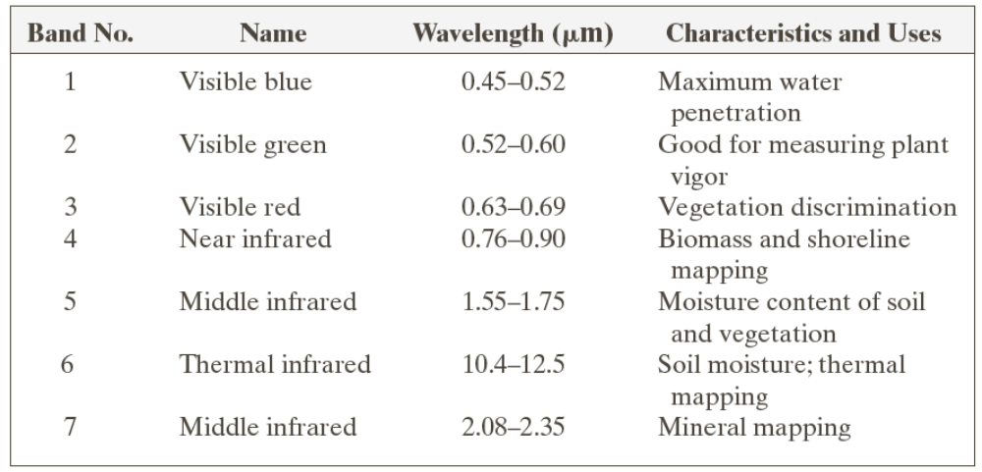
Examples: Visual and Infrared Imaging
Weeks 1 & 2

Slide 11
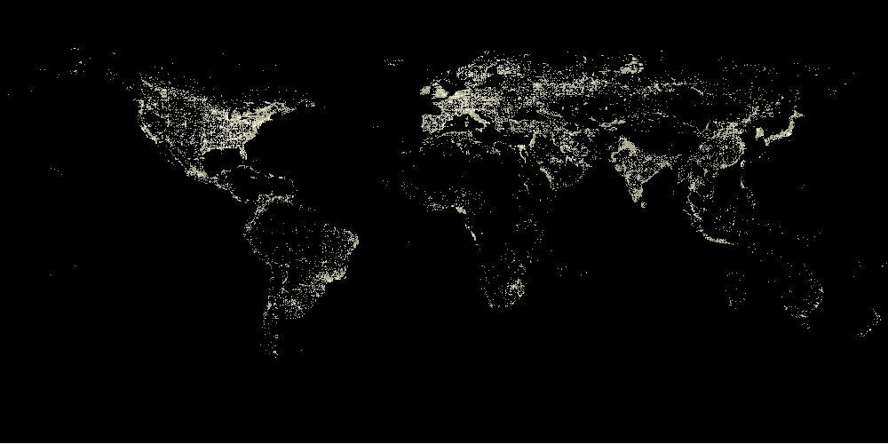
Examples: Infrared Satellite Imaging
Weeks 1 & 2

Slide 12
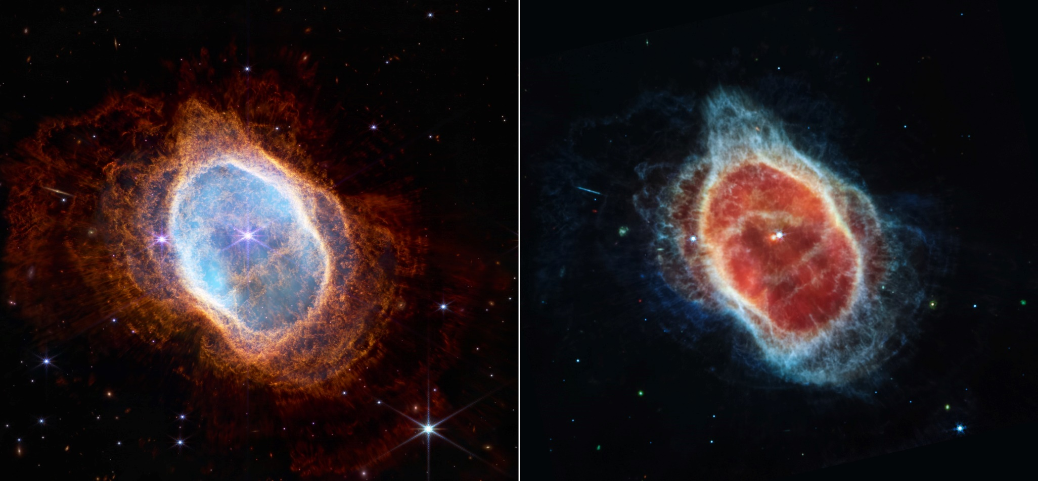
Example: NASA’s James Webb Space Telescope
Image of Southern ring planetary nebula. The left side is an image from the NIRcam instrument, the right side is the image from the MIRI instruments
Weeks 1 & 2

Slide 13
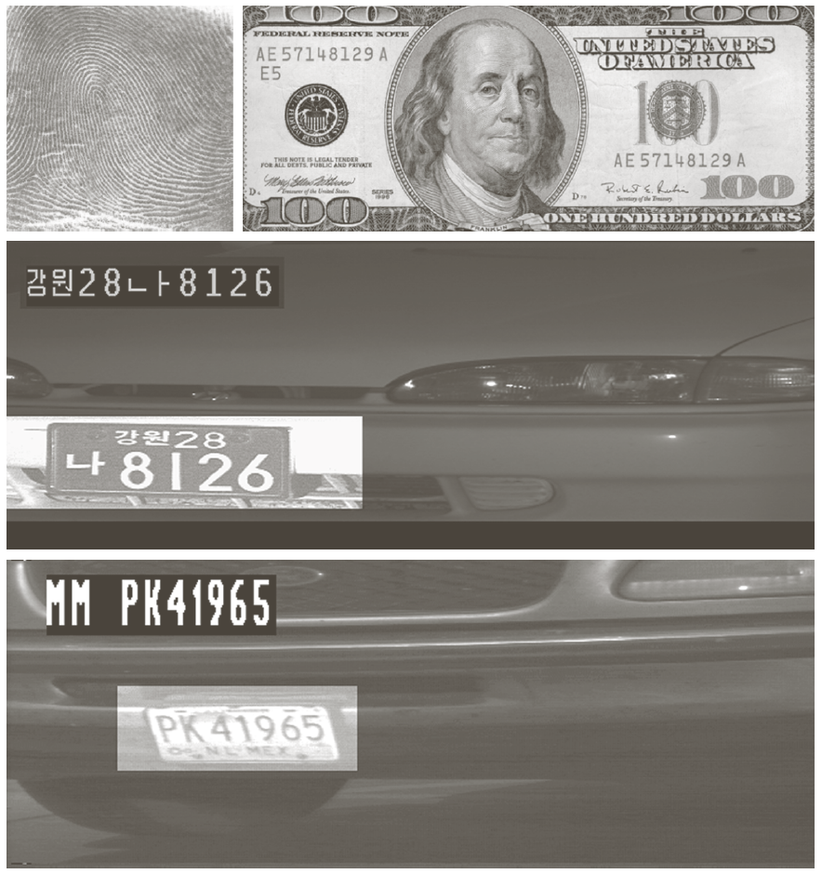
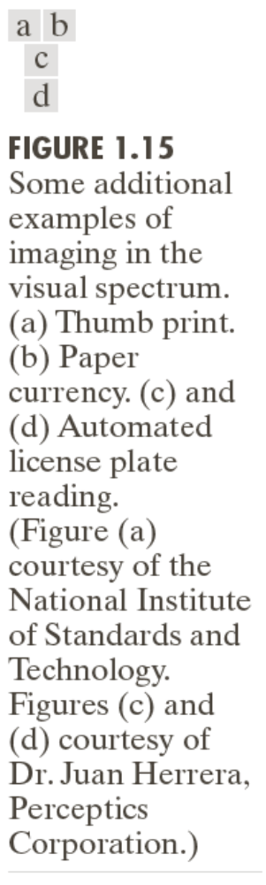
Examples: Automated Visual Inspection
Results of automated reading of the plate content by the system
The area in which the imaging system detected the plate
Weeks 1 & 2

Slide 14
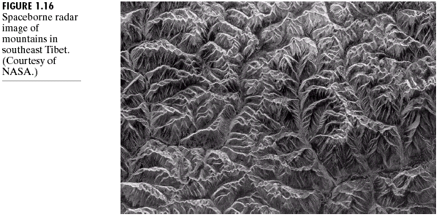
Example of Radar Image
Weeks 1 & 2

Slide 15
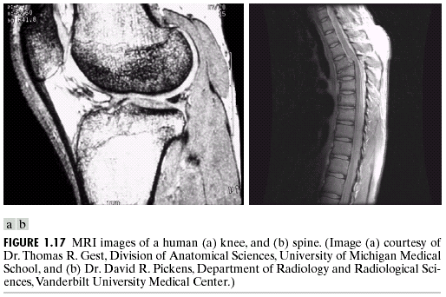
Examples: MRI (Radio Band)
Weeks 1 & 2

Slide 16
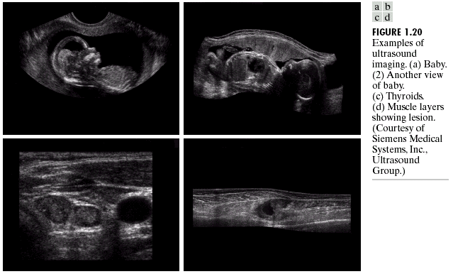
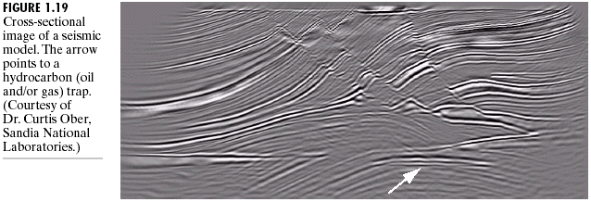
Examples: Ultrasound Imaging
Weeks 1 & 2

Slide 17
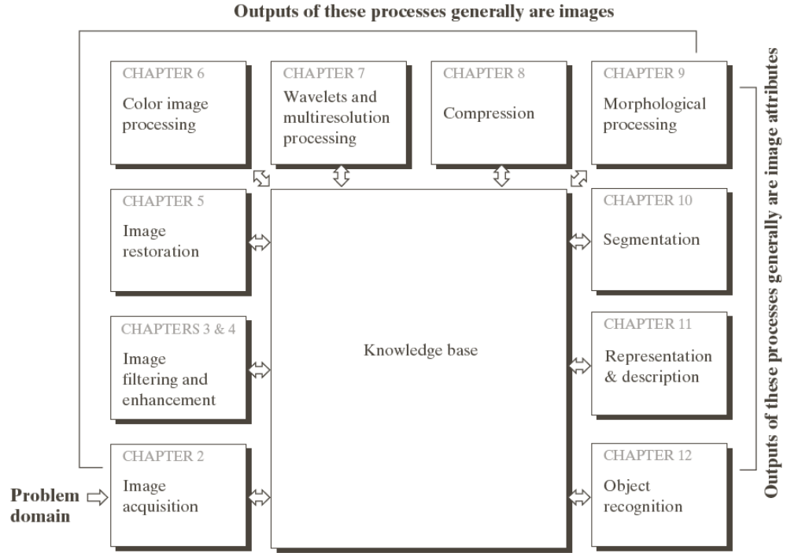
Fundamental Steps in DIP
Extracting image components
Improving the appearance
Partition an image into its constituent parts or objects
Result is more suitable than the original
Represent image for computer processing
Weeks 1 & 2

Slide 18
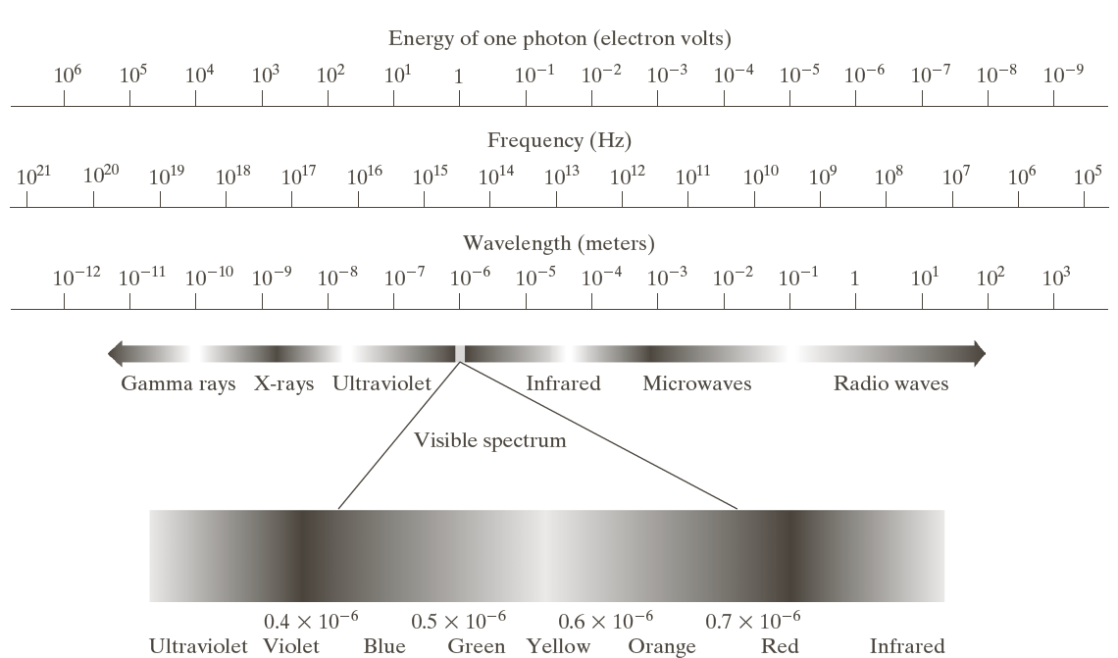
Light and EM Spectrum
Weeks 1 & 2

Slide 19
Light and EM Spectrum
The colors that humans perceive in an object are determined by the nature of the light reflected from the object.
e.g. green objects reflect light with wavelengths primarily in the 500 to 570 nm range while absorbing most of the energy at other wavelength
Weeks 1 & 2

Slide 20
Light and EM Spectrum
Monochromatic light: void of color
Intensity is the only attribute, from black to white
Monochromatic images are referred to as gray-scale images
Chromatic light bands: 0.43 to 0.79 um
The quality of a chromatic light source:
Radiance: total amount of energy
Luminance (lm): the amount of energy an observer perceives from a light source
Brightness: a subjective descriptor of light perception that is impossible to measure. It embodies the achromatic notion of intensity and one of the key factors in describing color sensation.
Weeks 1 & 2

Slide 21
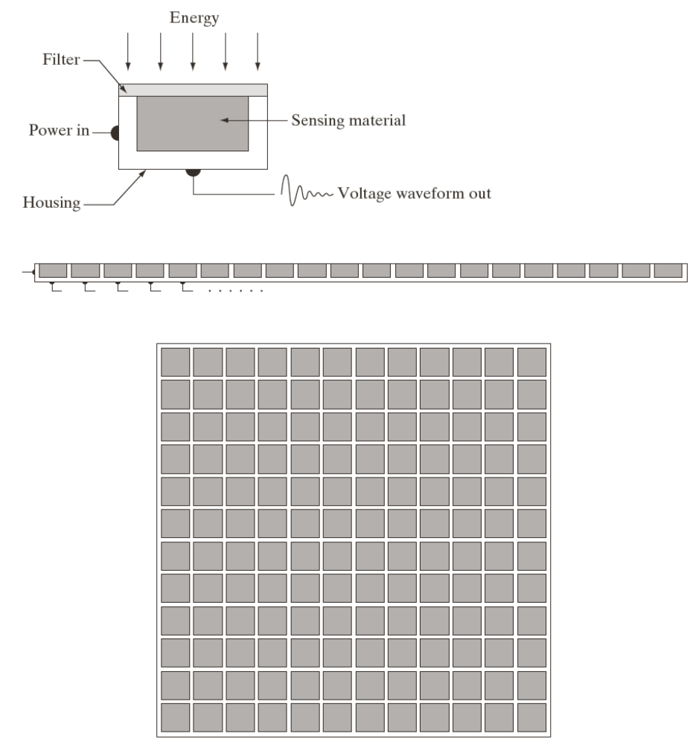
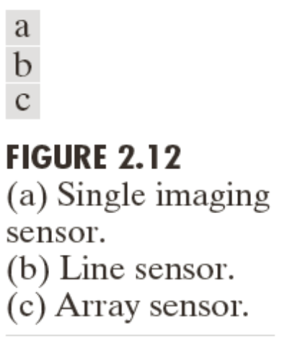
Image Acquisition
Transform illumination energy into digital images
Weeks 1 & 2

Slide 22

Image Acquisition Process
Weeks 1 & 2

Slide 23
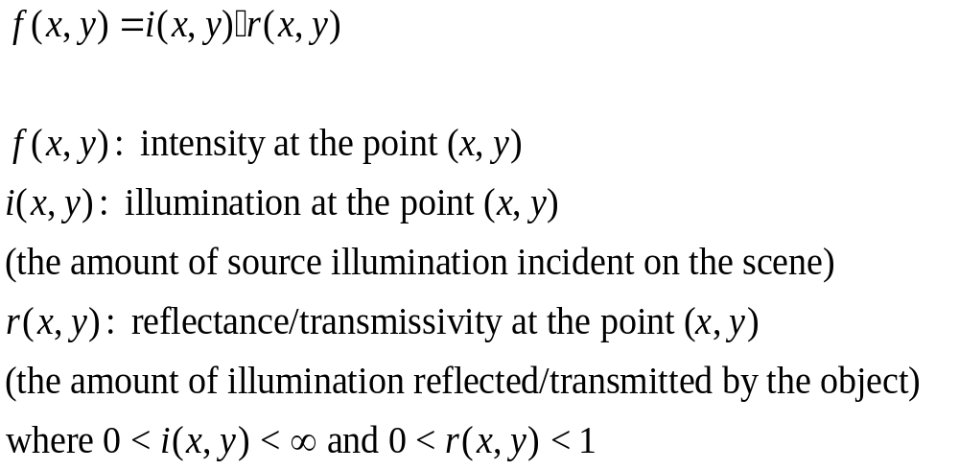
A Simple Image Formation Model
Weeks 1 & 2

Slide 24
Some Typical Ranges of illumination
Illumination
  Lumen — A unit of light flow or luminous flux
  Lumen per square meter (lm/m²) — The metric unit of measure for illuminance of a surface
  On a clear day, the sun may produce in excess of 90,000 lm/m² of illumination on the surface of the Earth
  On a cloudy day, the sun may produce less than 10,000 lm/m² of illumination on the surface of the Earth
  On a clear evening, the moon yields about 0.1 lm/m² of illumination
  The typical illumination level in a commercial office is about 1000 lm/m²
Weeks 1 & 2

Slide 25
Some Typical Ranges of Reflectance
Reflectance
  0.01 for black velvet
  0.65 for stainless steel
  0.80 for flat-white wall paint
  0.90 for silver-plated metal
  0.93 for snow
Weeks 1 & 2

Slide 26
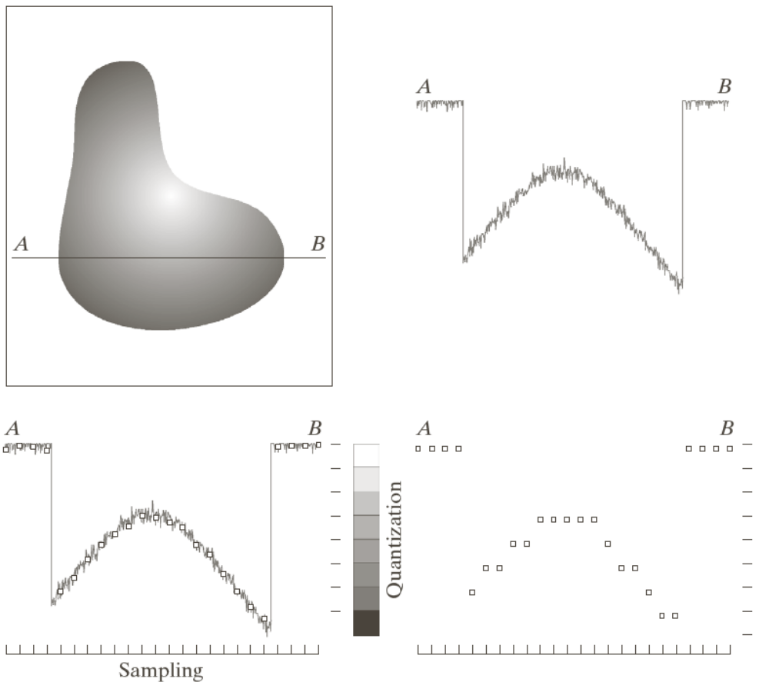
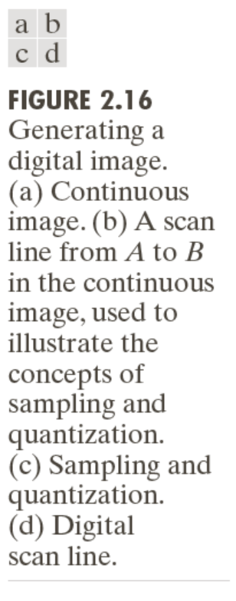
Image Sampling and Quantization
Digitizing the coordinate values(sampling)
Digitizing the amplitude values (quantization)
Weeks 1 & 2

Slide 27
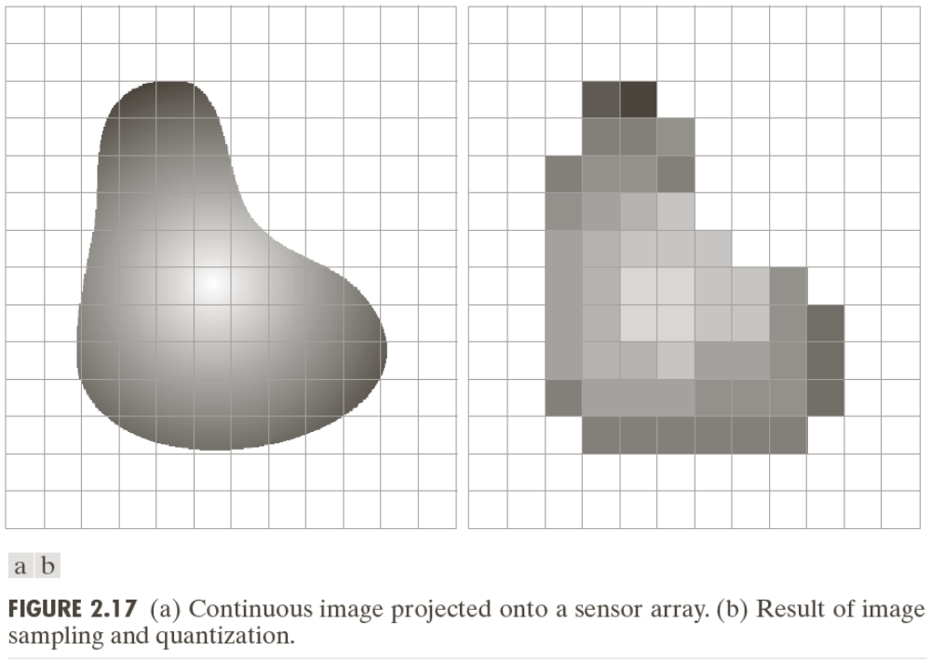
Image Sampling and Quantization
Weeks 1 & 2

Slide 28
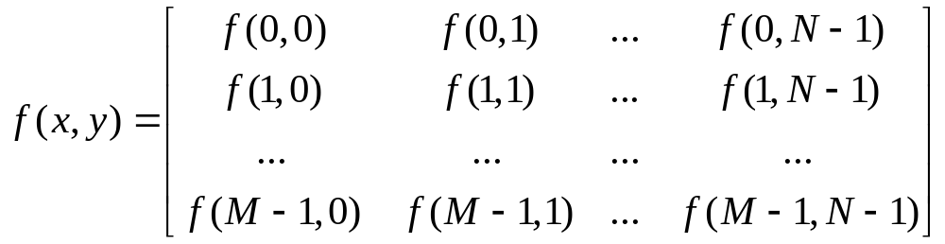
Representing Digital Images
The representation of an M×N numerical array as
Weeks 1 & 2

Slide 29
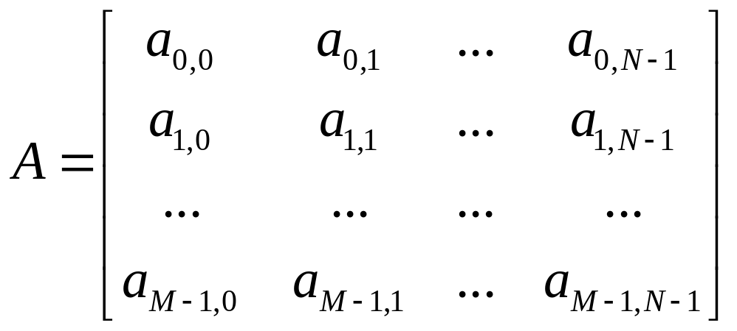
Representing Digital Images
The representation of an M×N numerical array as
Weeks 1 & 2

Slide 30
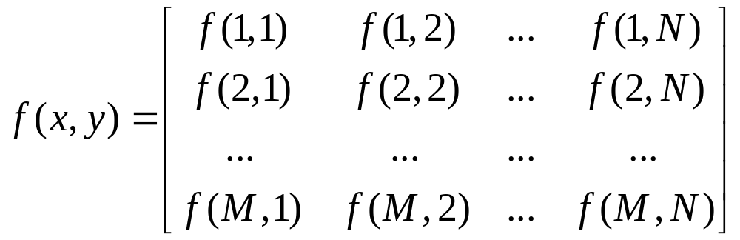
Representing Digital Images
The representation of an M×N numerical array in MATLAB
Weeks 1 & 2

Slide 31
Representing Digital Images
Discrete intensity interval [0, L-1], L=2^{k}
The number b of bits required to store a M × N digitized image
b = M × N × k
Weeks 1 & 2

Slide 32
Image Interpolation
Interpolation — Process of using known data to estimate unknown values
e.g., zooming, shrinking, rotating, and geometric correction
Interpolation (sometimes called resampling) — an imaging method to increase (or decrease) the number of pixels in a digital image.
Some digital cameras use interpolation to produce a larger image than the sensor captured or to create digital zoom
Weeks 1 & 2

Slide 33
Image Interpolation:
Nearest Neighbor Interpolation
Nearest neighbor is the most basic and requires the least processing time of all the interpolation algorithms because it only considers one pixel — the closest one to the interpolated point. This has the effect of simply making each pixel bigger.
Weeks 1 & 2

Slide 34
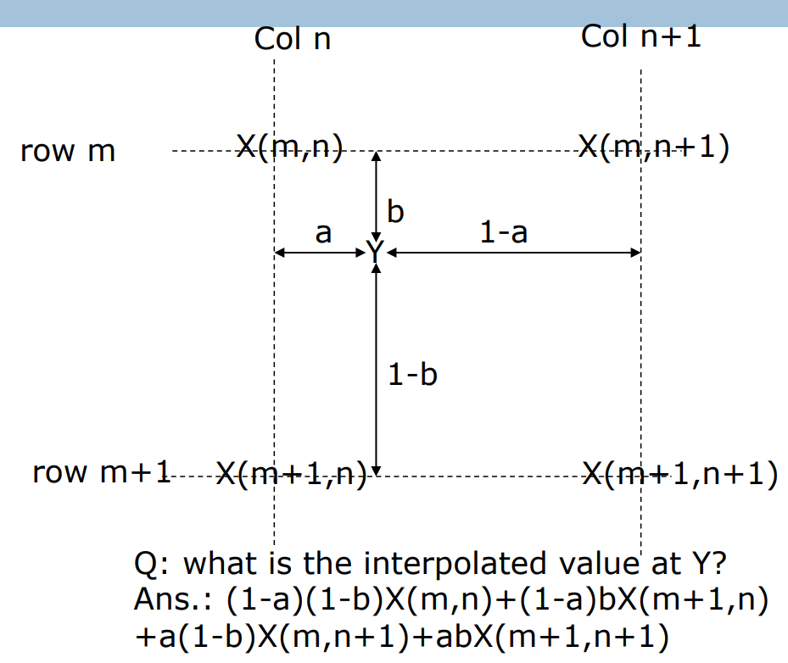
Image Interpolation:
Bilinear Interpolation
Weeks 1 & 2

Slide 35
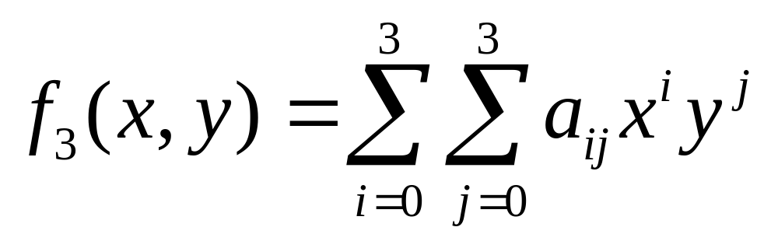
Image Interpolation:
Bicubic Interpolation
The intensity value assigned to point (x,y) is obtained by the following equation
The sixteen coefficients are determined by using the sixteen nearest neighbors.
http://en.wikipedia.org/wiki/Bicubic_interpolation
Weeks 1 & 2

Slide 36
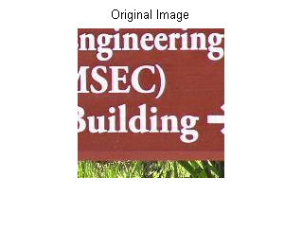
Examples: Interpolation
Weeks 1 & 2

Slide 37
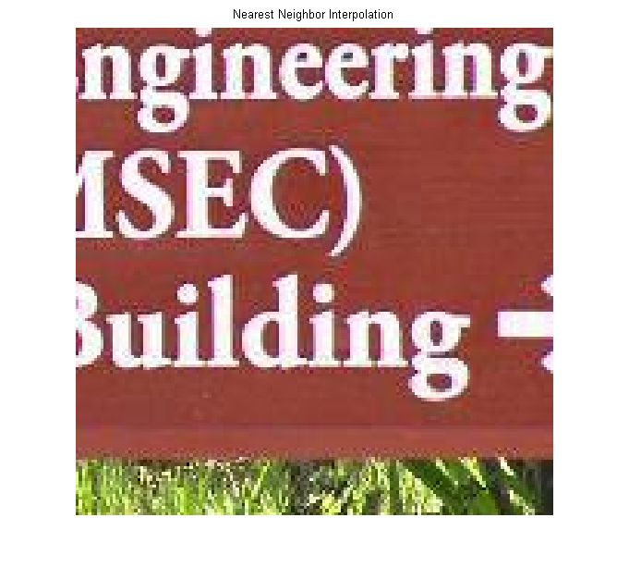
Examples: Interpolation
Weeks 1 & 2

Slide 38

Examples: Interpolation
Weeks 1 & 2

Slide 39

Examples: Interpolation
Weeks 1 & 2

Slide 40
Basic Relationships Between Pixels
Neighborhood
Adjacency
Connectivity
Paths
Regions and boundaries
Weeks 1 & 2

Slide 41
Basic Relationships Between Pixels
Neighbors of a pixel p at coordinates (x,y)
4-neighbors of p, denoted by N₄(p):
(x-1, y), (x+1, y), (x,y-1), and (x, y+1).
4 diagonal neighbors of p, denoted by N_{D}(p):
(x-1, y-1), (x+1, y+1), (x+1,y-1), and (x-1, y+1).
8 neighbors of p, denoted N₈(p)
N₈(p) = N₄(p) U N_{D}(p)
Weeks 1 & 2

Slide 42
Basic Relationships Between Pixels
Adjacency
Let V be the set of intensity values used to define adjacency
4-adjacency: Two pixels p and q with values from V are 4-adjacent if q is in the set N₄(p).
8-adjacency: Two pixels p and q with values from V are 8-adjacent if q is in the set N₈(p).
Weeks 1 & 2

Slide 43
Basic Relationships Between Pixels
Adjacency
Let V be the set of intensity values
m-adjacency: Two pixels p and q with values from V are m-adjacent if
(i) q is in the set N₄(p), or
(ii) q is in the set N_{D}(p) and the set N₄(p) ∩ N₄(q) has no pixels whose values are from V.
Weeks 1 & 2

Slide 44
Basic Relationships Between Pixels
Path
A (digital) path (or curve) from pixel p with coordinates (x₀, y₀) to pixel q with coordinates (x_{n}, y_{n}) is a sequence of distinct pixels with coordinates
(x₀, y₀), (x₁, y₁), …, (x_{n}, y_{n})
Where (x_{i}, y_{i}) and (x_{i-1}, y_{i-1}) are adjacent for 1 ≤ i ≤ n.
Here n is the length of the path.
If (x₀, y₀) = (x_{n}, y_{n}), the path is closed path.
We can define 4-, 8-, and m-paths based on the type of adjacency used.
Weeks 1 & 2

Slide 45
Examples: Adjacency and Path
V = {1, 2}
0 1 1 0 1 1 0 1 1
0 2 0 0 2 0 0 2 0
0 0 1 0 0 1 0 0 1
Weeks 1 & 2

Slide 46
Examples: Adjacency and Path
V = {1, 2}
0 1 1 0 1 1 0 1 1
0 2 0 0 2 0 0 2 0
0 0 1 0 0 1 0 0 1
8-adjacent
Weeks 1 & 2

Slide 47
Examples: Adjacency and Path
V = {1, 2}
0 1 1 0 1 1 0 1 1
0 2 0 0 2 0 0 2 0
0 0 1 0 0 1 0 0 1
8-adjacent
m-adjacent
Weeks 1 & 2

Slide 48
Examples: Adjacency and Path
V = {1, 2}
01,1 11,2 11,3 0 1 1 0 1 1
02,1 22,2 02,3 0 2 0 0 2 0
03,1 03,2 13,3 0 0 1 0 0 1
8-adjacent
m-adjacent
The 8-path from (1,3) to (3,3):
(1,3), (1,2), (2,2), (3,3)
(1,3), (2,2), (3,3)
The m-path from (1,3) to (3,3):
(1,3), (1,2), (2,2), (3,3)
Weeks 1 & 2

Slide 49

Basic Relationships Between Pixels
Connected in S
Let S represent a subset of pixels in an image. Two pixels p with coordinates (x₀, y₀) and q with coordinates (x_{n}, y_{n}) are said to be connected in S if there exists a path
(x₀, y₀), (x₁, y₁), …, (x_{n}, y_{n})
Where
Weeks 1 & 2

Slide 50
Basic Relationships Between Pixels
Boundary (or border)
The boundary of the region R is the set of pixels in the region that have one or more neighbors that are not in R.
If R happens to be an entire image, then its boundary is defined as the set of pixels in the first and last rows and columns of the image.
Weeks 1 & 2

Slide 51
Question 1
In the following arrangement of pixels, are the two regions (of 1s) adjacent? (if 8-adjacency is used)
1 1 1
1 0 1
0 1 0
0 0 1
1 1 1
1 1 1
Region 1
Region 2
Weeks 1 & 2

Slide 52
Question 2
In the following arrangement of pixels, are the two parts (of 1s) adjacent? (if 4-adjacency is used)
1 1 1
1 0 1
0 1 0
0 0 1
1 1 1
1 1 1
Part 1
Part 2
Weeks 1 & 2

Slide 53
In the following arrangement of pixels, the two regions (of 1s) are disjoint (if 4-adjacency is used)
1 1 1
1 0 1
0 1 0
0 0 1
1 1 1
1 1 1
Region 1
Region 2
Weeks 1 & 2

Slide 54
Question 3
In the following arrangement of pixels, the circled point is part of the boundary of the 1-valued pixels if 8-adjacency is used, true or false?
0 0 0 0 0
0 1 1 0 0
0 1 1 0 0
0 1 1 1 0
0 1 1 1 0
0 0 0 0 0
Weeks 1 & 2

Slide 55
Question 4
In the following arrangement of pixels, the circled point is part of the boundary of the 1-valued pixels if 4-adjacency is used, true or false?
0 0 0 0 0
0 1 1 0 0
0 1 1 0 0
0 1 1 1 0
0 1 1 1 0
0 0 0 0 0
Weeks 1 & 2

Slide 56
Distance Measures
Given pixels p, q and z with coordinates (x, y), (s, t), (u, v) respectively, the distance function D has following properties:
D(p, q) ≥ 0 [D(p, q) = 0, iff p = q]
D(p, q) = D(q, p)
D(p, z) ≤ D(p, q) + D(q, z)
Weeks 1 & 2

Slide 57
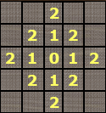
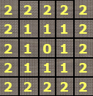
Distance Measures
The following are the different Distance measures:
a. Euclidean Distance :
D_{e}(p, q) = [(x-s)² + (y-t)²]^{1/2}
b. City Block Distance:
D₄(p, q) = |x-s| + |y-t|
c. Chess Board Distance:
D₈(p, q) = max(|x-s|, |y-t|)
Weeks 1 & 2

Slide 58
Question 5
In the following arrangement of pixels, what’s the value of the chessboard distance between the circled two points?
0 0 0 0 0
0 0 1 1 0
0 1 1 0 0
0 1 0 0 0
0 0 0 0 0
0 0 0 0 0
Weeks 1 & 2

Slide 59
Question 6
In the following arrangement of pixels, what’s the value of the city-block distance between the circled two points?
0 0 0 0 0
0 0 1 1 0
0 1 1 0 0
0 1 0 0 0
0 0 0 0 0
0 0 0 0 0
Weeks 1 & 2

Slide 60
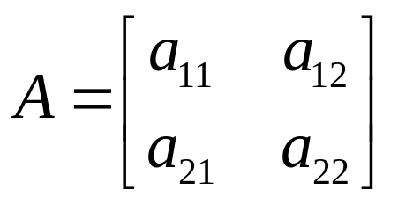
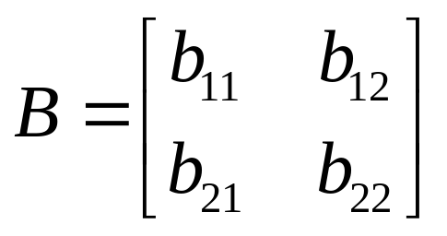
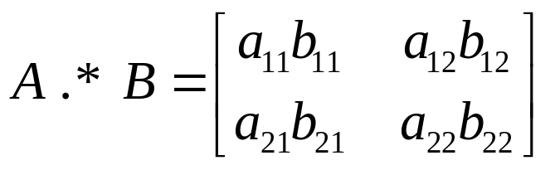
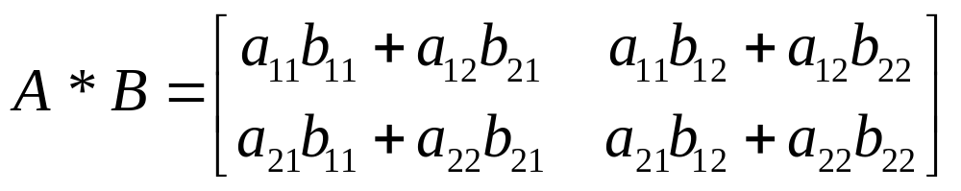
Introduction to Mathematical Operations in DIP
Array vs. Matrix Operation
Array product
operator
Array product
Matrix product
operator
Matrix product
Weeks 1 & 2

Slide 61
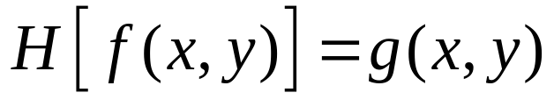
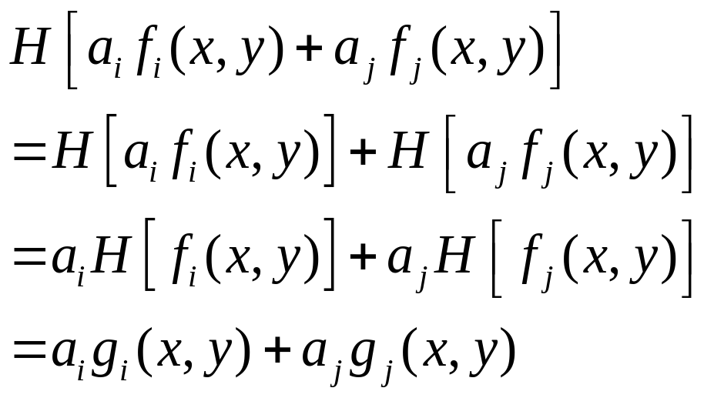
Introduction to Mathematical Operations in DIP
Linear vs. Nonlinear Operation
H is said to be a linear operator;
H is said to be a nonlinear operator if it does not meet the above qualification.
Additivity
Homogeneity
Weeks 1 & 2

Slide 62
Arithmetic Operations
Arithmetic operations between images are array operations. The four arithmetic operations are denoted as
s(x,y) = f(x,y) + g(x,y)
d(x,y) = f(x,y) – g(x,y)
p(x,y) = f(x,y) × g(x,y)
v(x,y) = f(x,y) ÷ g(x,y)
Weeks 1 & 2

Slide 63
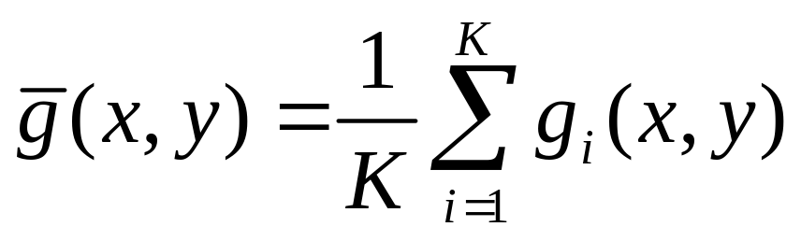
Example: Addition of Noisy Images for Noise Reduction
Noiseless image: f(x,y)
Noise: n(x,y) (at every pair of coordinates (x,y), the noise is uncorrelated and has zero average value)
Corrupted image: g(x,y)
g(x,y) = f(x,y) + n(x,y)
Reducing the noise by adding a set of noisy images, {g_{i}(x,y)}
Weeks 1 & 2

Slide 64
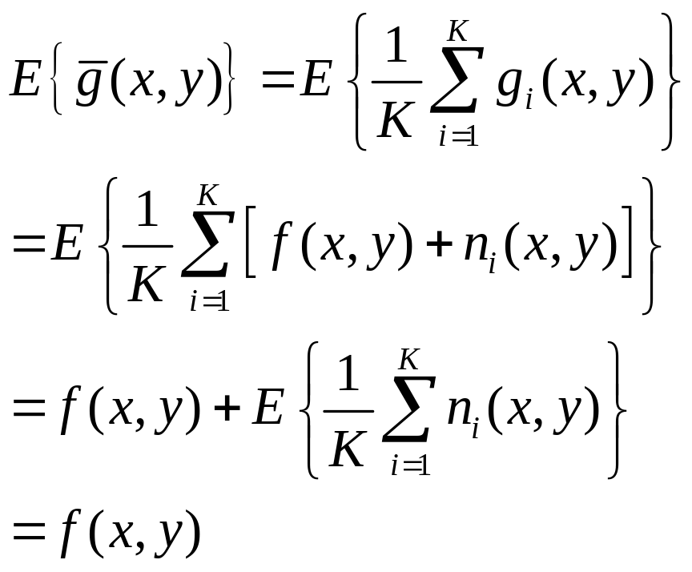
Example: Addition of Noisy Images for Noise Reduction
Weeks 1 & 2

Slide 65
Example: Addition of Noisy Images for Noise Reduction
In astronomy, imaging under very low light levels frequently causes sensor noise to render single images virtually useless for analysis.
In astronomical observations, similar sensors for noise reduction by observing the same scene over long periods of time. Image averaging is then used to reduce the noise.
Weeks 1 & 2

Slide 66
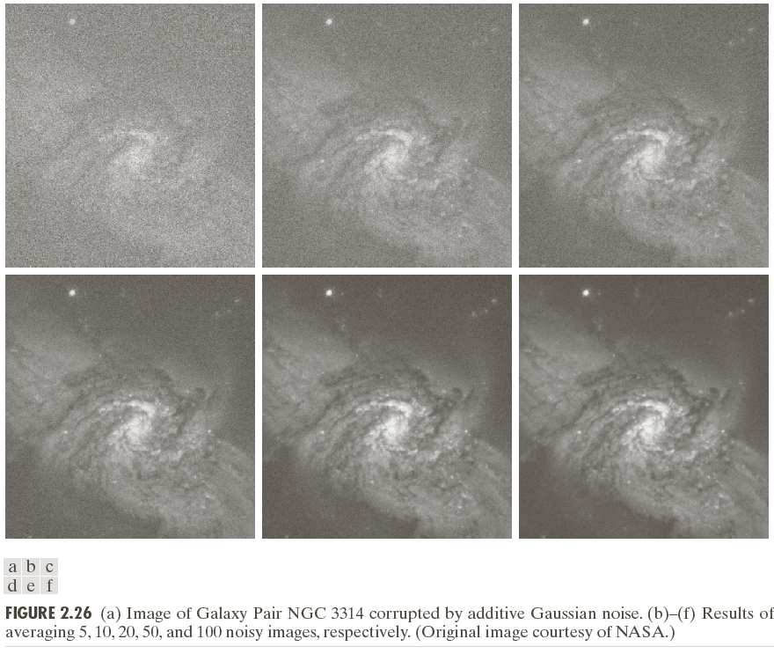
Weeks 1 & 2

Slide 67
An Example of Image Subtraction: Mask Mode Radiography
Mask h(x,y): an X-ray image of a region of a patient’s body
Live images f(x,y): X-ray images captured at TV rates after injection of the contrast medium
Enhanced detail g(x,y)
g(x,y) = f(x,y) - h(x,y)
The procedure gives a movie showing how the contrast medium propagates through the various arteries in the area being observed.
Weeks 1 & 2

Slide 68
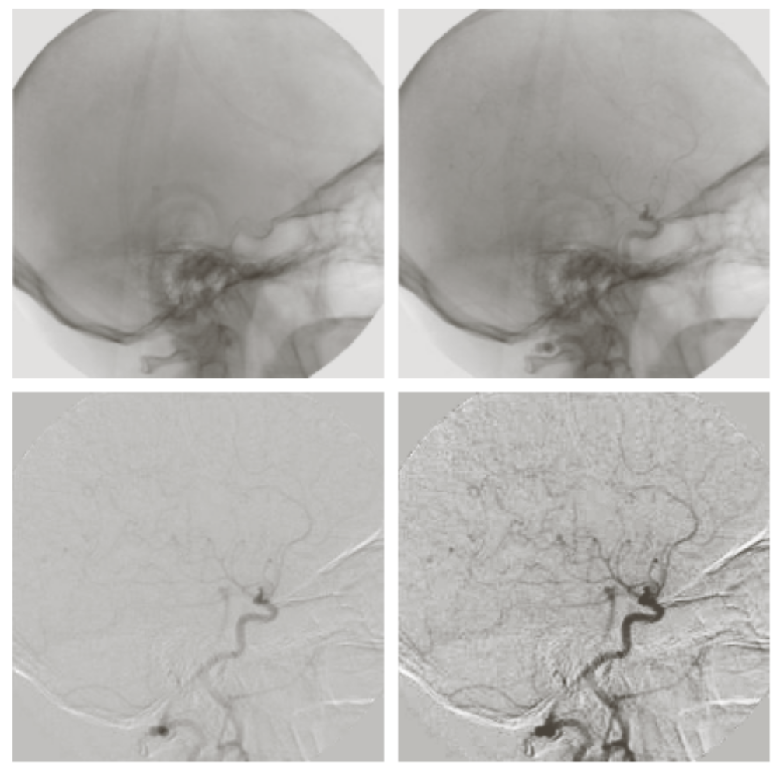
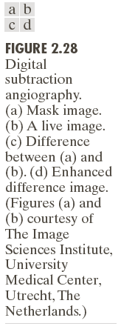
Weeks 1 & 2

Slide 69
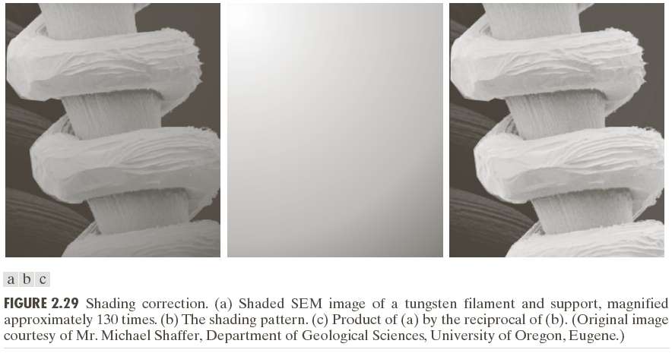
An Example of Image Multiplication
Weeks 1 & 2

Slide 70
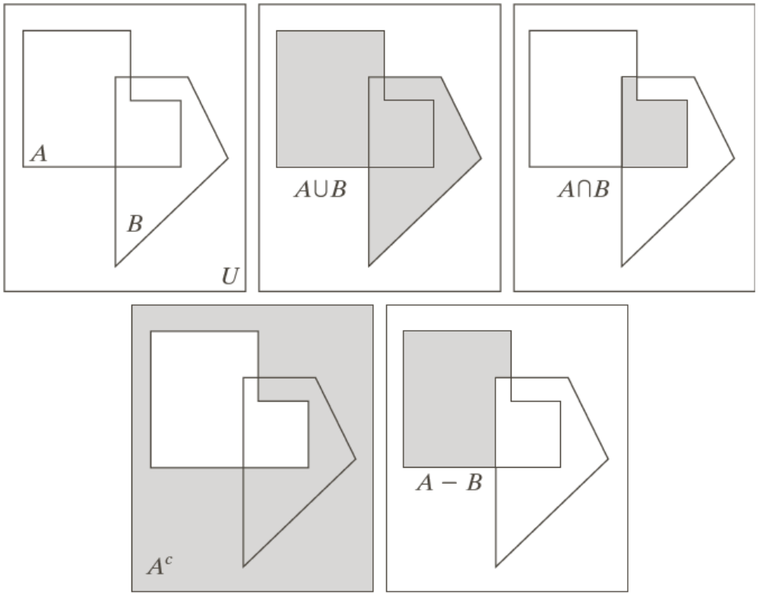

Set and Logical Operations
Weeks 1 & 2

Slide 71


Set and Logical Operations
Let A be the elements of a gray-scale image
The elements of A are triplets of the form (x, y, z), where x and y are spatial coordinates and z denotes the intensity at the point (x, y).
The complement of A is denoted A^{c}
Weeks 1 & 2

Slide 72


Set and Logical Operations
Weeks 1 & 2

Slide 73


Set and Logical Operations
Weeks 1 & 2

Slide 74



Spatial Operations
Single-pixel operations
Alter the values of an image’s pixels based on the intensity.
e.g.,
Weeks 1 & 2

Slide 75


Geometric Spatial Transformations
Geometric transformation (rubber-sheet transformation)
— A spatial transformation of coordinates
— intensity interpolation that assigns intensity values to the spatially transformed pixels.
Affine transform
Weeks 1 & 2

Slide 76

Weeks 1 & 2

Slide 77

Intensity Assignment
Forward Mapping
It’s possible that two or more pixels can be transformed to the same location in the output image.
Inverse Mapping
The nearest input pixels to determine the intensity of the output pixel value.
Inverse mappings are more efficient to implement than forward mappings.
Weeks 1 & 2

Slide 78

Example: Image Rotation and Intensity Interpolation
Weeks 1 & 2

Slide 79
Image Registration
Input and output images are available but the transformation function is unknown.
Goal: estimate the transformation function and use it to register the two images.
One of the principal approaches for image registration is to use tie points (also called control points)
The corresponding points are known precisely in the input and output (reference) images.
Weeks 1 & 2

Slide 80

Image Registration
A simple model based on bilinear approximation:
Weeks 1 & 2

Slide 81


Image Registration
Weeks 1 & 2

Slide 82

Image Transform
A particularly important class of 2-D linear transforms, denoted T(u, v)
Weeks 1 & 2

Slide 83

Image Transform
Given T(u, v), the original image f(x, y) can be recoverd using the inverse tranformation of T(u, v).
Weeks 1 & 2

Slide 84


Image Transform
Weeks 1 & 2

